Slide 1
Teaching Academic Language in a Science Classroom
Dellice Berezan, Marjorie Charles & Sherri Selby
Mar 24, 2011
EDPY 413

Slide 2
Overview
Introduction in the use and importance of academic language in science classes (Sherri).
Research-based strategies for teaching academic language in science classes and sample activities (Marjorie & Dellice).

Slide 3
Introduction

Slide 4
Academic Language (AL)
Cognitive, context-reduced language (Cummins, 1989)
A specific stylistic register (Solomon & Rhodes, 1995)
Language of the classroom, workplace, text, assessment and academic success (Scarcella, 2008)

Slide 5
AL in Science
  Science is about generating and interpreting data. But it is also about communicating facts, ideas, and hypotheses. Scientists write, speak, debate, visualize, listen, and read about their specialties daily. For students unfamiliar with the language or style of science, the deceptively simple act of communication can be a barrier to understanding or becoming involved with the science (Hines, Wible & McCartney, 2010, p. 447).

Slide 6
Types of AL in Science
General AL (mortar)
Functional language, connectives, etc.
  E.g.: define photosynthesis, describe photosynthesis; compare and contrast photosynthesis to the process of respiration
  E.g.: Photosynthesis and respiration are similar because they require. . . However, photosynthesis combines carbon dioxide and water …while respiration consumes the energy stored in sugar etc.
Content AL (bricks)
Key vocabulary
  E.g. solar energy, chemical reaction, chloroplast, mitochondria, energy balance, photosynthesis, carbon dioxide, oxygen, conversion, energy, storage, glucose, nutrients, respiration, energy consumption, NADPH/NADH, ATP/ADP
(Natural Resources Canada, 2007; Zwiers, 2008)

Slide 7
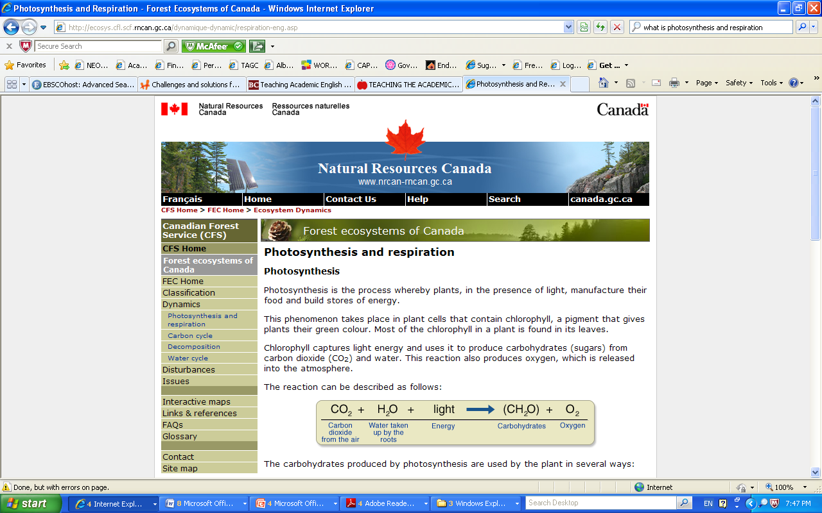
Example of AL in Science
content
From Natural Resources Canada, 2007
general
Notes:
Green, blue, grey=reference words and their referents

Slide 8
Scientific AL: Vocabulary
One chapter of a grade 8 science text was found to contain 300 very challenging words, phrasal verbs, concepts or technical formulaic phrases (Miller, 2009).
In a review of science texts for grades 6-9, an average of 2500 new or unfamiliar words were introduced in a typical course: double what would be expected in a language course grades 6-9 (Yager,1983).
Of particular importance: “90% of [American] teachers use a textbook 95% of the time” (Yager, 1983, p. 578).
What do you think of the Alberta Program of Studies and textbooks? Do you find them to be too vocabulary-focused?

Slide 9
Challenges for English Language Learners (ELLs) in Science
Edmonds (2009) outlines the primary challenges for ELLs in science:
  Relating to [North] American ways of perceiving the sciences.
  Understanding what is being taught in the classroom.
  Using AL to discuss scientific concepts.
  Participating in class discussion, and writing appropriate scientific academic texts.

Slide 10
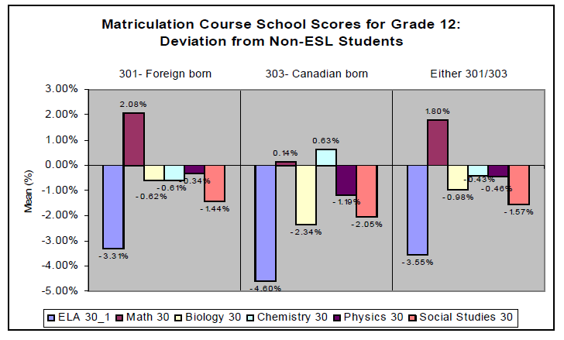
ELL Performance on Diploma Exams
On average, when compared to their native-speaking peers, Albertan ELLs
  Perform poorer on diploma exams with a large language component (e.g., English 30, Biology 30, Chemistry 30, Physics 30).
  Perform better on the diploma exam for Math 30.
From Coalition for Equal Access to Education, 2007, p.11.
Notes:
Review synopsis of Day 9

Slide 11
Challenges of Teaching Science to ELLs (Identified by Classroom Teachers)
Top 5 Challenges Faced by Classroom Teachers
 | % Elementary | % Secondary
1.Teacher-parent/community communication | 26.7 | 16.1
2. Lack of time to teach ELLs | 22.3 | 9.34
3. Variability in student academic needs/levels | 18.9 | 19.5
4. Lack of appropriate tools and materials | 15.9 | 13.8
5. Teacher-ELL communication | 15.6 | 22.6
or Encouraging/motivating Els | 6.4 | 20.4
(Center for the Future of Teaching and Learning, 2005, Table in Survey Findings)
Notes:
http://www.cftl.org/centerviews/july05.html
Science teachers are not generally well prepared to help their students penetrate the linguistic puzzles that science texts present. They of course recognize that teaching vocabulary is key, but typically focus on the science vocabulary (the
bolded words in the text), often without recognizing that those bolded words are defined with general-purpose academic words that students also do not know

Slide 12
Challenges of Teaching Science to ELLs (from the Literature)
Common problems (Lee, 2004; Snow, 2010):
Teachers typically focus on the content vocabulary.
Failure to recognize the interdependence of science and language.
Failure to recognize that general and content AL need to be taught.
Lack of professional development relating to helping their students understand science texts/discourse.
Difficulty in linking students’ primary language/culture with scientific knowledge and discourse.

Slide 13
Summary
There is a somewhat overwhelming amount of AL required in an average science course.
Science courses present ELLs with a number of difficulties. This can result in poorer performance.
Science teachers are in need of strategies to effectively teach AL in science classes (coming up next).
Questions?

Slide 14
Strategies for Teaching Science to ELLs
Part I: General strategies for teaching AL that are applicable to science classes:
Separation of language and content
Differentiation of instruction
Integration of language and science instruction
Part II: Strategies for teaching AL that are supported by the nature of science itself:
Culturally responsive instruction
Collaborative inquiry-based instruction

Slide 15
Strategies for Teaching ELLs in science Classes
Part 1 of II

Slide 16
Separation of Language and Content
Language-based approaches:
As discussed in class, Herrell and Jordan (2008) suggest that teachers provide scaffolding by introducing and reviewing academic vocabulary and language structures.
  E.g. High School Biology Lesson (Photosynthesis)
    The teacher would highlight and define terms such as reaction, chloroplast, chlorophyll, pigment, energy, mitochondria, carbon dioxide, oxygen, glucose, etc. at the beginning of the lesson. They would then be reviewed at the end of the lesson.

Slide 17
Separation of Language and Content
Meyer (2000) suggests that teachers reduce the “language load” of ELLs by limiting the number of unfamiliar words they will be exposed to in a lesson.
  E.g. Elementary School Science Lesson (Plants)
    Books could be selected with varying reading levels in mind (e.g. varying number of pictures, diagram,s etc.).
The New Teacher Centre (2005) recommends explicit instruction of AL.
  E.g. Junior High Science (Transpiration)
    Conduct a laboratory demonstration of transpiration (e.g. using celery) using the AL required thus providing visual cues to facilitate understanding.

Slide 18
Separation of Language and Content
Content-first approach
In a study by Brown and Ryoo (2008), science instruction using common language first was shown to improve comprehension for grade 5 students.
Study parameters:
  Control group - taught a new subject using scientific language.
  Treatment group - concept was described using common language prior to the introduction of scientific terminology.
Results: .The treatment group showed improvement in comprehension demonstrated by:
  Written (constructed and selected) responses.
  Oral explanation of concepts.

Slide 19
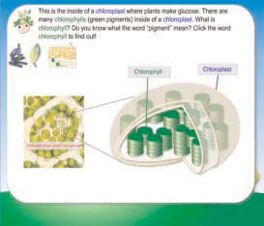
Content-First Instruction Example
“This is the inside of a chloroplast where plants make glucose. There are many chlorophylls (green pigments) inside of a chloroplast’’ (Brown & Ryoo, 2008, p. 540).
How could you re-word this to focus on content?
(Brown & Ryoo, 2008, p. 540)

Slide 20
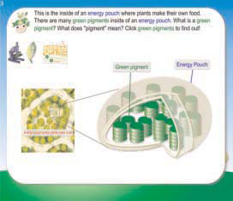
Content-First Instruction Example
“This is the inside of an energy pouch where plants make their own food. There are many green pigments inside of an energy pouch” (Brown & Ryoo, 2008, p. 540).
(Brown & Ryoo, 2008, p. 540)

Slide 21
Differentiation
Refers to the presentation of material in a variety of ways and the provision of options regarding how students can demonstrate their understanding (Tomlinson, 2001).
Reported to improve student performance in science
  The implementation of a differentiated science curriculum improved student achievement on in-school and state-wide assessments in a study of American middle-schools (Mastropieri et al., 2006).
  Differentiation based on readiness was also shown to improve comprehension for students with lower levels of background knowledge (Omdal, 2007).

Slide 22
Differentiation: Examples for ELLs
Beckett and Hayley (2000) recommend that teachers create a “language rich” classroom in order to reduce the language-related strain experienced by ELLs.
  E.g.: graphic organizers, multiple media styles available (print, audio, video, etc.)
The New Teacher Centre (2005) recommends that teachers use a variety of visual aids, including pictures, diagrams, and charts.
  E.g. Junior High Science (Plant Unit)
    Place vocabulary posters and brightly-coloured diagrams around your classroom. Diagrams should include parts of the plant and the different processes you are teaching your students, at the level you want them to understand.

Slide 23
Differentiation: Examples for ELLs
Herrell and Jordan (2008) suggest the inclusion of technology as an additional source of information to facilitate the development of AL and content knowledge.
  E.g. High School Science (Plant cells)
    Online virtual tours through plant cells or instructional videos.
  Note: Technology can also be used to allow for differentiation by product (i.e. students may demonstrate their understanding using technology).
Robinson (2005) reports that robotics-driven activities improve scientific literacy and AL development for ELLs.

Slide 24
Integration of Language and Science Instruction
Several methodologies have been designed to improve the integration of AL and content instruction in science:
  SIOP (Sheltered instruction observation protocol)- advocates the development of language objectives that parallel the content objectives for the lesson (Echevarria, 2005).
    The effect of SIOP on middle school science achievement of ELLs is underway http://www.cal.org/create/research/siopscience.html

Slide 25
Sample Language Objectives
0-6 months
(Piper & Shaw, 2010, p.70)

Slide 26
Integration of Language and Science Instruction
  Stoddart, Pinal, Latzky, and Canaday (2002) created a rubric for integrating inquiry science and AL instruction with the intent of promoting the highest levels of integration (where AL and content are taught together in a way that is synergistic).
  Lee and Fradd (1998) describe a framework for “instructional congruence” wherein science and literacy are taught simultaneously for the benefit of all students, especially ELLs (see next slide).

Slide 27
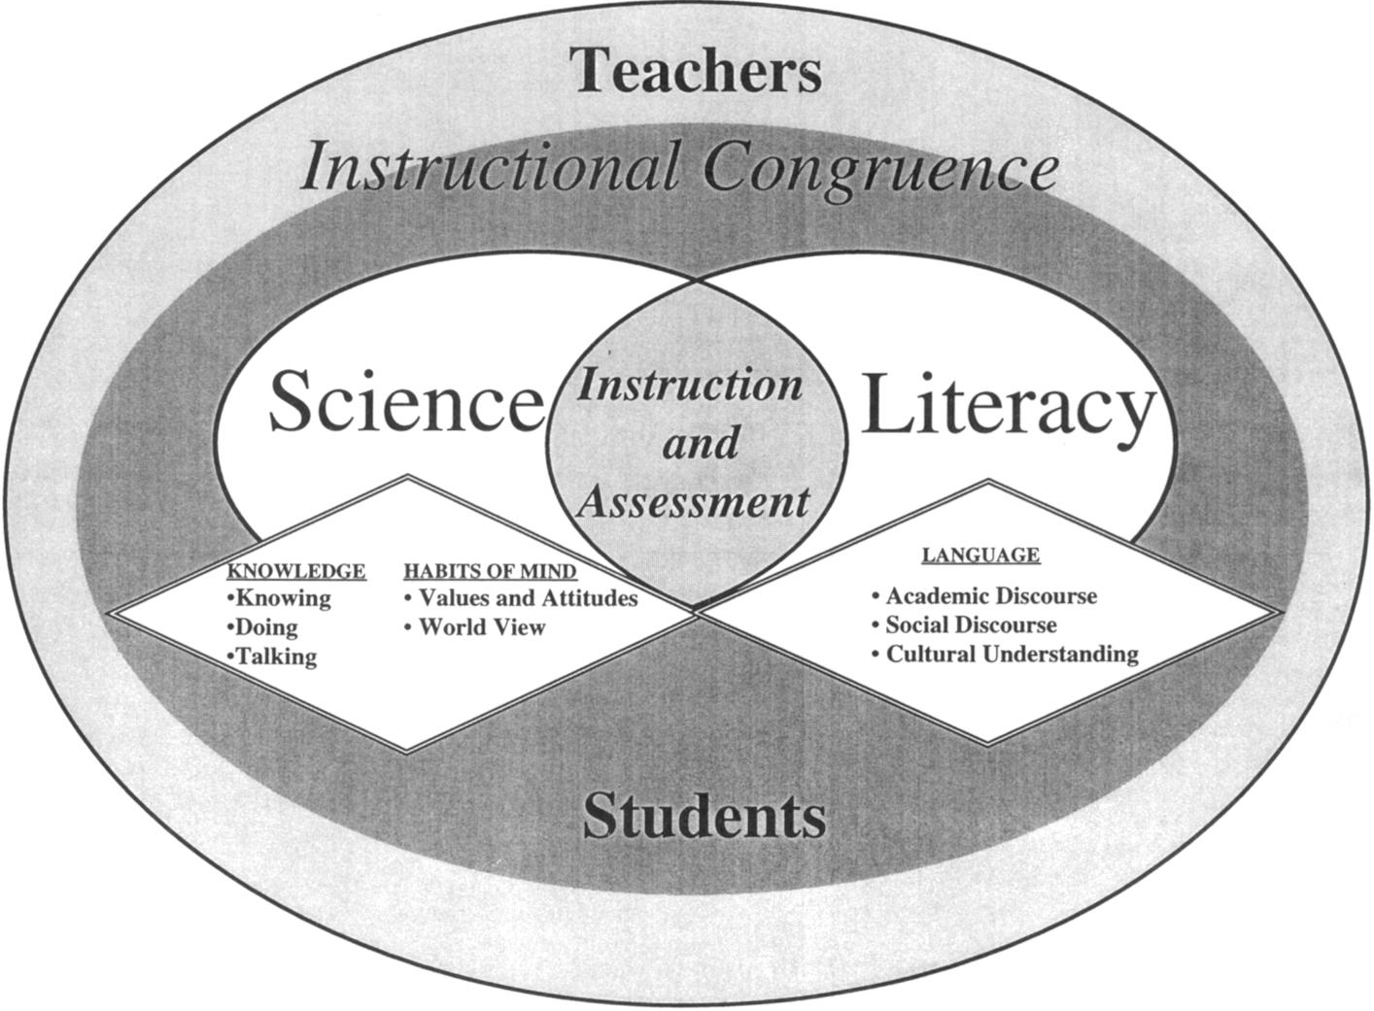
“Instructional Congruency”
Must be included to provide equitable instruction to ELLs
Traditionally overrepresented
(Lee & Fradd, 1998, p. 13)

Slide 28
Strategies for Teaching ELLs in science Classes
Part II of II

Slide 29
The Nature of Science
Teaching students how science works (a.k.a. the nature of science) is a key facet of the Alberta Program of Studies.
In teaching the nature of science, it is natural to employ strategies that are beneficial for ELLs (in the development of AL and content knowledge) based on two key principles (Reeves, Chessin, & Chambless, 2007):
  Science is culturally embedded (i.e. the approach taken, observations recorded and conclusions reached depend on the cultural background of the scientist).
  Scientific knowledge is the result of collaboration, interaction and shared understanding.

Slide 30
The Nature of Science
Presenting science as a culturally embedded “way of knowing” provides an ideal springboard for culturally responsive instruction.
Presenting scientific knowledge as the result of collaborative efforts provides an ideal springboard for collaborative, inquiry-based instruction.
Both of these styles of instruction are beneficial for ELLs (Education Alliance at Brown University, 2006; Amaral, Garrison & Klentschy, 2002).

Slide 31
Culturally Responsive Instruction
Designed to improve academic performance and motivation for ELLs and English-speaking minorities (Education Alliance at Brown University, 2006).
In science classes, culturally responsive instruction can be incorporated in numerous ways, including:
  Science is presented as a way of knowing. Alternative ways of knowing are discussed and validated.
  Students’ experiences are legitimized and existing knowledge is engaged.

Slide 32
Culturally Responsive Instruction
Science is a way of knowing. Alternative ways of knowing are discussed and validated.
Students whose cultures utilize different ways of knowing and communicating (e.g. oral history) find the conventions of western science counter-intuitive.
    E.g. Aboriginal students are more often chastised in schools (Solomon & Rhodes, 1995).
Meyer (2000) recommends being sensitive to this “cultural load” for ELLs
  E.g. High School Biology (Ecology Unit)
    Students are introduced to Aboriginal understandings of the ecosystem prior to the Western scientific conceptions about them. No more value is placed on one than the other.

Slide 33
Culturally Responsive Instruction
Students’ experiences are legitimized and existing knowledge is engaged:
Lee and Fradd (1998) recommend that teachers assist students in identifying relevant experiences and link them to the subject at hand.
Herell and Jordan (2008) recommend that teachers design and teach an introductory activity to engage students’ existing knowledge.
E.g. Junior High Science (Plants)
Bring a plant to class and ask students what they know about plants (i.e. they are green, grow in dirt, need water, need sun, etc.)
Based on the students’ prior knowledge, explain plant characteristics using AL (i.e. green → pigment, chlorophyll, chloroplast; plant requirements → equation for photosynthesis).

Slide 34
Collaborative, Inquiry-Based Instruction
Provide students with a problem or question as well as scaffolding needed for the students to collaboratively answer that problem or question.
This method has been recommended:
  To allow students to experience (and thus become familiar with) key aspects of the nature of science (i.e. that scientific understanding is generated based on the efforts of many) (Uno et al, 1994).
  To utilize authentic problems and contexts to promote student engagement and interest (Hassard, 2005).
  To encourage community involvement (Hanes & Saddler, 2005).

Slide 35
Collaborative, Inquiry-Based Instruction
Study by Amaral, Garrison and Klentschy (2002)
  El Centro School District (k-8) with 84.9% of students being Hispanic with strong ties to Mexico.
  Implemented a hands-on science curriculum consisting of a series of “kits”.
Findings
  Improved academic performance in science (selected response).
  Improved written response skills.
  Improved reading and mathematical skills.
This study suggests that inquiry-based science classes may be of benefit to ELLs.

Slide 36
Collaborative, Inquiry-Based Instruction
Other aspects of this approach have also been specifically recommended for ELLs to assist in the acquisition of AL.
  Collaborative activities
    Herrell and Jordan (2008) recommend that students practice AL in pairs or small groups allowing them to practice using AL in authentic ways with their peers.
    The New Teacher Center (2005) recommends using guided interaction, wherein students work together to understand what they read.
      E.g. Encourage students to form small groups/pairs and work together to answer questions or review the material.

Slide 37
Collaborative, Inquiry-Based Instruction
  Authentic Contexts
    The New Teacher Center (2005) recommends the use of meaning-based contexts and universal themes to foster student interest.
    The New teacher Center (2005) also recommends the use of authentic assessments rather than those which require memorization or other lower order thinking processes.
    Meyer (2000) suggests that meaningful learning opportunities may reduce the cognitive and language-related stress experienced by ELLs.
  If your goal is for students to understand nutrient exchange between plants and the environment (e.g., water, carbon dioxide, sunlight), how would you design a collaborative, inquiry-based activity?

Slide 38
Collaborative, Inquiry-Based Instruction
Traditional science laboratory activity
  Students are provided with a procedure, the required materials in order to determine what materials plants require from the environment and what materials they release. Students follow the “recipe”.
Collaborative, inquiry-based activity
  Students are provided with the question and then design ways to answer it. Teacher provides scaffolding as needed.
  More creative and more student-centered
    Note that this type of student-centered activity is also recommended for culturally-responsive education (Education Alliance at Brown University, 2006).

Slide 39
Conclusion
AL is of key importance in science classrooms.
Strategies for teaching AL in science classes include:
  Separation of language and content
  Differentiation of instruction
  Integration of language and science instruction
  Culturally responsive instruction
  Collaborative inquiry-based instruction

Slide 40
Discussion Questions
Which of the proposed strategies do you find most appealing?
What is your experience of utilizing these (or other strategies) for teaching AL in content courses?
Can you see these strategies being of use in other subject areas?

Slide 41
References
Amaral, O.M., Garrison, l., & Klentschy, M. (2002). Helping English learners increase achievement through inquiry-based science instruction. Bilingual Research Journal, 26(2), 213-239.
Beckett, E., & Haley, P. (2000). Using standards to integrate academic language into ESL fluency. The Clearing House, 74(2), 102-104.
Brown, B.A., & Ryoo, K. (2008). Teaching science as a language: A ``content-first`` approach to science teaching. Journal of Research in Science Teaching, 45(5), p. 529-553.
Center for the Future of Teaching and Learning. (2005). Listening to teachers of English language learners. Retrieved from http://www.cftl.org/centerviews/july05.html
Coalition for Equal Access to Education. (2007). Responses to the review of ESL K-12 program implementation in Alberta [PDF Document]. Retrieved from http://www.eslaction.com/main/responses%20to%20K-12%20review%202006.pdf
Cummins, J. (1981). The role of primary language development in promoting educational success for language minority students. In Schooling and language minority students: A theoretical framework (pp. 3-50). Los Angeles, CA: California State University.
Echevarria, J. (2005). Using SIOP in science: Response to Settlage, Madsen and Rustad. Issues in Teacher Education, 14(1), 51-62.
Edmonds, L . (2009). Challenges and solutions for ELLs. The Science Teacher, 76, 30-33.
Education Alliance at Brown University. (2006). Teaching diverse learners: Culturally responsive teaching. Retrieved from http://www.alliance.brown.edu/tdl/tl-strategies/crt-principles.shtml
Hanes, J., & Sadler, T. (2005). Inquiry into community. The Science Teacher, 72( 4), 42-43.
Hassard, J. (2005). Models of teaching science. The art of teaching science (pp. 237-254). New York, NY: Oxford University Press.

Slide 42
References Continued
Herrell, A. L., & Jordan, M. (2008). 50 Strategies for teaching English language learners (3rd ed.). Upper Saddle River, NJ: Pearson Education, Inc.
Hines, P.J., Wible, B., & McCartney, M. (2010). Learning to read, reading to learn. Science, 328(5977), 447.
Lee, O. (2004). Science Education with English language learners: Synthesis and research agenda. Review of Educational Research, 75(4), 419-530 Lee, O., & Fradd, S.H. (1998). Science for all, including students from non-English-language backgrounds. Educational Reseacher, 27(4), 12-21.
Mastropieri, M., Scruggs, T., Norland, J., Berkeley, S., McDuffie, K., & Tornquist, E. (2006). Differentiated curriculum enhancement in inclusive middle school science: Effects on classroom and high-stakes tests. The Journal of Special Education, 40(3), 130-137.
Meyer, L. (2000). Barriers to meaningful instruction for English learners. Theory into Practice, 39(4), 228-236.
Miller, J. (2009). T eaching refugee learners with interrupted education in science: Vocabulary, literacy and pedagogy. International Journal of Science Education, 31, 571–592.
Natural Resources Canada. (2007). Photosynthesis and respiration. Retrieved from http://ecosys.cfl.scf.rncan.gc.ca/dynamique-dynamic/respiration-eng.asp
New Teacher Center. (2005). Six key strategies for teachers of English-language learners [PDF Document]. Retrieved from http://www.all4ed.org/files/archive/publications/SixKeyStrategies.pdf
Omdal, S.N. (2007). Effects of tiered instruction on academic performance in a secondary science course. Journal of Advanced Academics, 18, 424-453.
Piper, S., & Shaw, E. (2010). Teaching Photosynthesis with ELL Students. Science Activities, 47(3),68-74.

Slide 43
References Continued
Reeves, C., Chessin, D., & Chambless, M. (2007). Nurturing the nature of science. The Science Teacher, 74(8), p. 31-35.
Robinson, M. (2005). Robotics-driven activities: Can they improve middle school science learning? Bulletin of Science Technology Society, 25(1), 73-84.
Scarcella, R. (2008). Academic language for English language learners [PowerPoint Slides]. Retrieved from http://www.readingrockets.org/webcasts/3003#readings
Snow, C. (2010). Academic language and the challenge of reading for learning about science. Science, 328, 450-453.
Solomon, J., & Rhodes, N. (1995). Conceptualizing academic language. Washington, DC: National Center for Research on Cultural Diversity and Second Language Learning.
Stoddart, T., Pinal, A., Latzke, M., & Canaday,D. (2002). Integrating inquiry science and language development for English language learners. Journal of Research in Science Teaching, 39(8), 664-687.
Tomlinson, C. (2005). How to Differentiate Instruction in Mixed-Ability Classrooms (2nd ed.). Columbus, OH: Merril Prentice Hall.
Uno, G. E., & Bybee, R.W. (1994). Understanding the dimensions of biological literacy. Bioscience, 44(8), 553-557.
Yager, R. (1983). The importance of terminology in teaching K-12 science. Journal of Research in Science Teaching, 20(6), 577-588.
Zwiers, J. (2008). Building academic language: Essential practices for content classrooms. San Francisco, CA: John Wiley and Sons.

